Slide 1
Kentucky Design Crash Modification Factor Database
William Staats: MSCE
Eric Green: PhD, PE
Reg Souleyrette, PE, PhD, F. ASCE

Slide 2
Outline
Intro to CMFs
Where to find CMFs
Applying CMFs
Crash Costs (NSC)
CMF Example
SPR Purpose and Goal
Input from Audience
Notes:
This will be a more interactive session to gain an understanding of what the CMF needs are in Kentucky.

Slide 3
Crash Modification Factor (CMF)
CMFs is a multiplicative factor used to estimate a countermeasure’s expected safety benefit in terms of crash reduction
They can help identify countermeasures with the greatest safety benefit
Most CMFs are based on a limited number of study sites and specific crash conditions
Crash types
Crash severity
Urban/Rural classification

Slide 4
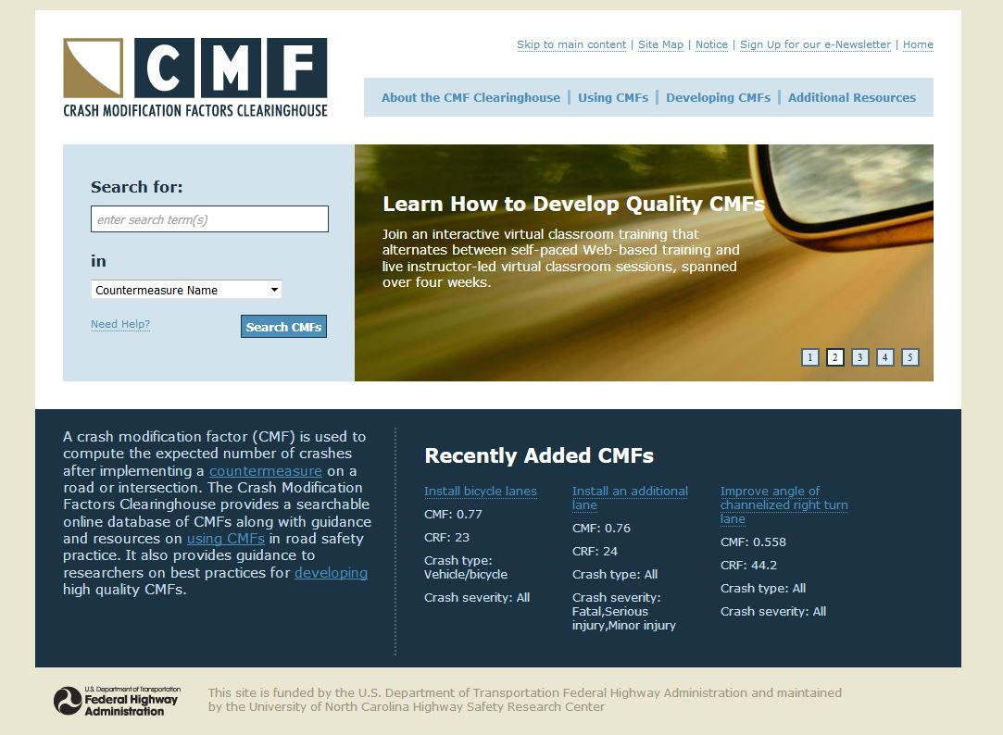
Where to find CMFs
CMF Clearinghouse
Highway Safety Manual
NCHRP Studies
Research Reports
Notes:
CMF clearinghouse has over 6400 CMFs

Slide 5
CMFs vs AFs
Different from Adjustment Factors
CMFs (HSM part D)*
Adjusts actual crashes at a site based on proposed changes
A site has 10 crashes per year and you want to decide between two countermeasures
AFs (HSM part C)
Adjusts crash prediction at a site that has different base conditions than the reference data used for SPF development
A site has 10 foot lanes but the state’s SPF was developed for 9 foot lanes
*Although you can use CMFs for future predictions using SPFs

Slide 6
How HSM Works
Predicted
Crashes
SPF
AF
C
Safety Performance Function(SPF): regression equation
Adjustment Factor (AF)
Calibration Factor (C): local adjustment
Notes:
The predicted crashes are the “expected average number of crashes”. The use of the SPF indicates the application of a statistical method and the answer is not an exact number, as is frequently the case in engineering, but rather a statistical
estimate. This means that if we record crashes in several sites with similar characteristics, then, on average, we can expect to measure that particular number.

Slide 7
Part C: Predictive Methods (1/3)
Safety Performance Functions (SPFs)
Regression models
Predict expected crash frequency
Developed from data for a number of similar sites
Developed for specific site types and “base conditions”
SPF
Notes:
SPFs are regression models that are developed using historical data from a set of sites with similar characteristics. Sites can be aggregated based on lane width, shoulder width and type, degree of curvature, presence of median or any other geometric features that could provide for such classification.
The model developed could predict the expected number of crashes for these sites and can be used to estimate crash performance for sites with similar features. The models establish the base conditions based on the common features of the sites used in the prediction. The models are typically a function of ADT.

Slide 8
SPF Development
SPF
Crashes/Year
Average Daily Traffic (ADT)
Notes:
Here is an example of how an SPF can be developed.
Assuming that the four data sets depict the crash experience over 5 years for a set of sites with similar features. It can be assumed that the all sites are 2-lane roads with 12-foot lanes, 8-foot shoulders, and no curves.
A curve is fitted through these 4 entities using a negative binomial regression formula. The line is the “best fit” of all the data and is the Safety Performance Function (SPF). The line represents the change in the mean expected number of crashes at all similar entities as ADT (or other exposure measure) increases, while all other factors affecting crash occurrence are held constant. It should be noted that this is an example and typically SPFs are based on a far greater number of sites for greater accuracy.
Sites that lie above the SPF indicate a mean expected crash frequency in excess of the average for comparable sites. One can think about sites with mean risk above the SPF as those with higher than average risk and those below the line as those with lower than average risk.
SPFs have been compiled into safety analysis tools, such as SafetyAnalyst and the Highway Safety Manual (HSM).
However, since crash patterns may vary in different geographical areas, SPFs must be calibrated to reflect local conditions (e.g., driver population, climate, crash reporting thresholds, etc.).

Slide 9
Part C: Predictive Methods (2/3)
Adjustment Factors (AFs)
Adjusts SPF predicted value
Accounts for differences between base conditions between a site being considered and the sites used for SPF development
AF

Slide 10
Part C: Predictive Methods (3/3)
Local calibration factor (C_{r})
-Adjusts SPF from HSM to local conditions
-Addresses local variations
C
Notes:
The purpose of the calibration factors is to adjust for differences in crash frequency for the initial regions of model development to those for local conditions.
The predictive methods included in Part C of the HSM were developed with data from select jurisdictions in the United States. These Part C models include Safety Performance Functions (SPFs), Crash Modification Factors (CMFs), and Calibration factors. Variations due to climate, driver populations, animal populations, crash reporting thresholds, and crash reporting system procedures are examples of unique variations that warrant the development of region-specific calibration factors.

Slide 11
Back to CMFs

Slide 12
How to Apply CMFs
CMFs should only be applied to the crash types and severities they are calibrated from
$Expected crashes after implementation = historic crashes∗CMF$
$Expected crash reduction=historic crashes∗(1−CMF)$
Expected crash reduction can be used to estimate a monetary value of safety benefit over a given study period

Slide 13
National Safety Council Crash Costs
Crash Type | Economic Cost | Comprehensive Cost
Fatality (K) | $1,550,000 | $10,080,000
Incapacitating Injury (A) | $90,000 | $1,100,000
Non-Incapacitating Injury (B) | $26,000 | $304,000
Possible Injury (C) | $21,000 | $140,000
Property Damage Only (O) | $4,200 | $8,500

Slide 14
Five ways to obtain a CMF (now)
Pick the best rated, or the “one on top”
Examine all possible CMFs, using only the summary info provided in the CMF Clearinghouse
Dig into each study that represents a CMF in the clearinghouse, and choose the one most relevant to your project.
Find information outside the CMF clearinghouse (a study or past experience)
Conduct a research study using crash data and develop your own CMF
How should the Cabinet do this?

Slide 15
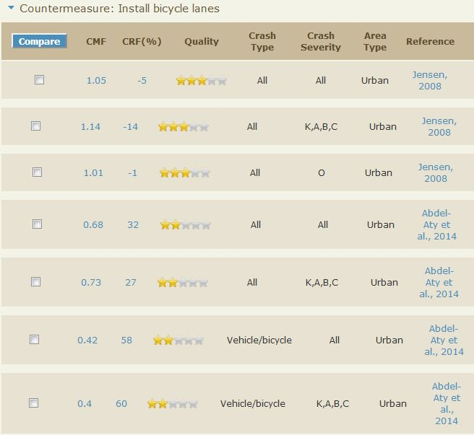
CMF Example: Bike Lane
Urban 2 Lane road
2 Miles
5-Yr Crash history:
Crash Type | Injury | PDO | Total
All Crashes | 20 | 25 | 45
Vehicle/Bike Crashes | 10 | 5 | 15
Which CMF do you use?
Notes:
Pick the top CMFs: Highest rating means they are the best, right?

Slide 16
CMF Example: Bike Lane
Urban 2 Lane road
2 Miles
5-Yr Crash history:
5-Yr Crash reduction
All crashes: 45*(1-1.05)= -2.25 crashes
Injury crashes: 20*(1-1.14)= -2.8 crashes
Crash Type | Injury | PDO | Total
All Crashes | 20 | 25 | 45
Vehicle/Bike Crashes | 10 | 5 | 15
Notes:
Attract more users, crashes go up. Notice this is an older study and research may suggest other trends.

Slide 17
CMF Example: Bike Lane
Urban 2 Lane road
2 Miles
5-Yr Crash history:
Crash Type | Injury | PDO | Total
All Crashes | 20 | 25 | 45
Vehicle/Bike Crashes | 10 | 5 | 15
Rethink CMF selection

Slide 18
CMF Example: Bike Lane
Urban 2 Lane road
2 Miles
5-Yr Crash history:
5-Yr Crash reduction
All Vehicle/bike crashes: 15*(1-0.42)= 8.7 crashes
Injury vehicle/bike crashes: 10*(1-0.4)= 6 crashes
Crash Type | Injury | PDO | Total
All Crashes | 20 | 25 | 45
Vehicle/Bike Crashes | 10 | 5 | 15
Notes:
Create safe space and separation for bicyclists, bike crashes go down.

Slide 19
CMF Example: Bike Lane
The higher star rating is data from Copenhagen
heavy bike traffic
The lower star study is using Florida bike data
more similar to Kentucky
Both use empirical Bayes and have statistically significant CMFs.
Without reading the reports, users would not know that one CMF is based on data from a country that has a very different bike culture than we have in Kentucky.

Slide 20
Lessons Learned
There are often multiple CMFs available for the same countermeasure
You should apply CMFs only to the crashes they are calibrated from
Safety benefits can change depending on the CMF chosen
You should know which crash types you are targeting in your design
Countermeasures that reduce one crash type may increase another crash type
Read the research report to select the most appropriate CMF

Slide 21
CMF Database SPR Project
Create a database of pre-approved design CMFs to standardize their use in Kentucky
Gain feedback from Kentucky CMF users to identify needs
Provide education on CMF applications: which CMF, when to use, how to apply it
Examples:
Wisconsin DOT
Guide
Excel
Planning level CMFs
Next slide…

Slide 22
Planning Level CMFs
Provided by VHB

Slide 23
Products of the CMF Project
Design CMF database
CMF evaluation form
Guidebook on selecting and applying CMFs for design projects
Identification of Kentucky’s CMF needs that are not currently fulfilled
Kentucky CMF committee
guides development of the list
approves waivers for use of alternative CMFs

Slide 24
Discussion
Share your experience with CMF use

Slide 25
Feedback
How do you use CMFs? On what types of projects?
What safety countermeasures do you use most commonly?
How would you like to access the database?

Slide 26
Data Viz is Important
https://www.autodeskresearch.com/publications/samestats

Slide 27
Contact Info
William Staats, MSCE
Research Engineer
Kentucky Transportation Center
william.staats@uky.edu
(859) 257-7254
Eric Green, PE, PhD
Assoc. Program Manager
Kentucky Transportation Center
eric.green@uky.edu
(859) 257-1815
Reg Souleyrette, PE, PhD, F. ASCE
Program Manager
Kentucky Transportation Center
souleyrette@uky.edu
(859) 257-5309

